Slide 2
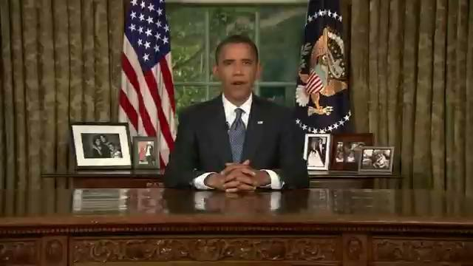

Slide 3
ML/AI Club
Welcome!
Notes:
biggest club!

Slide 4
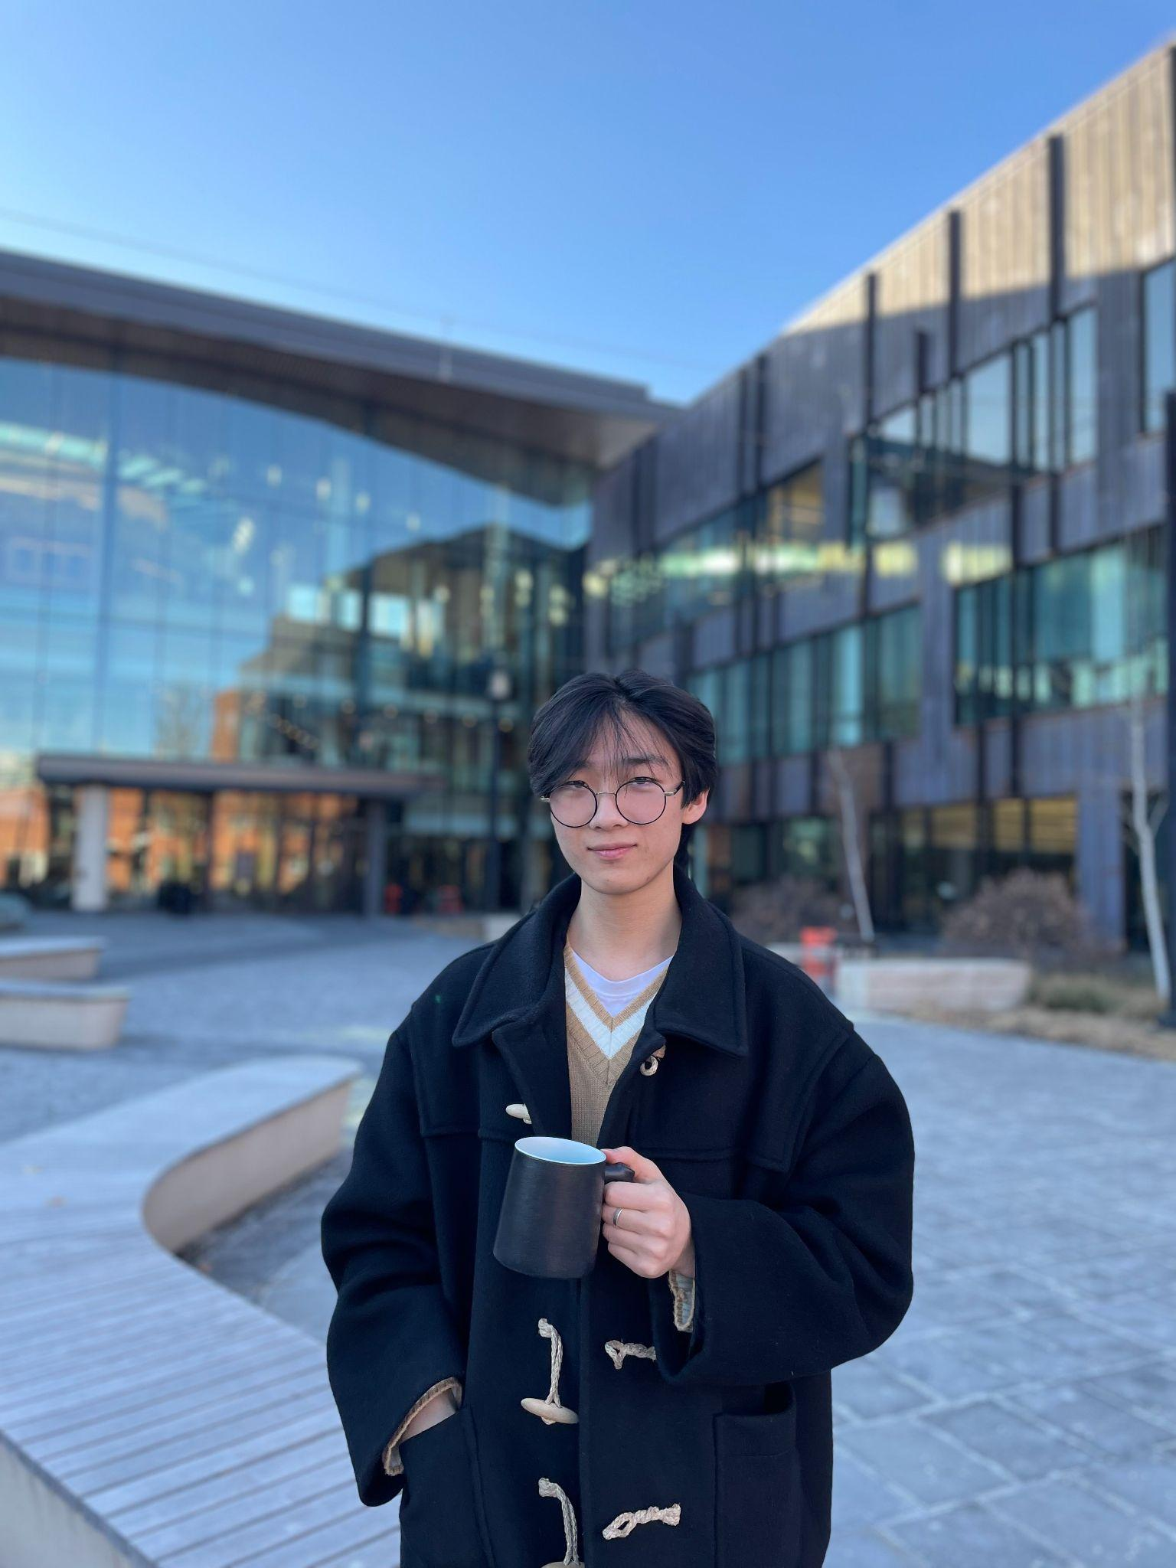
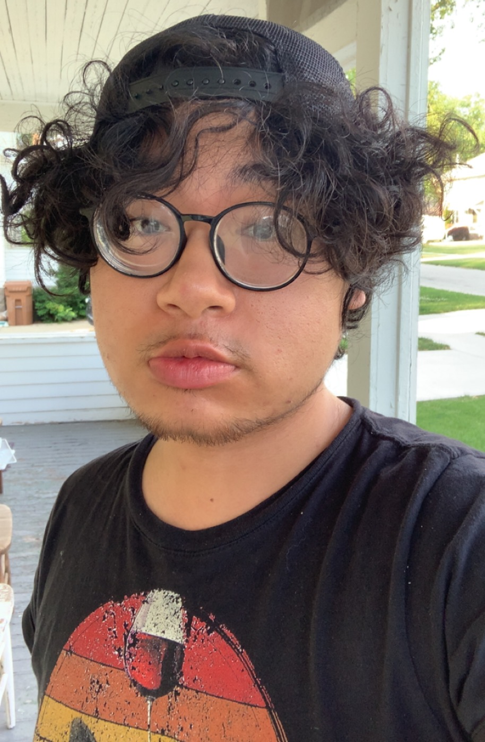
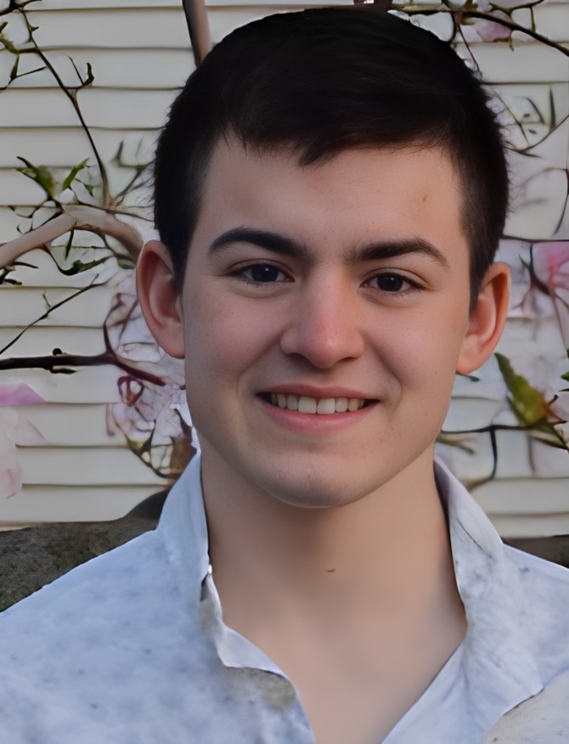
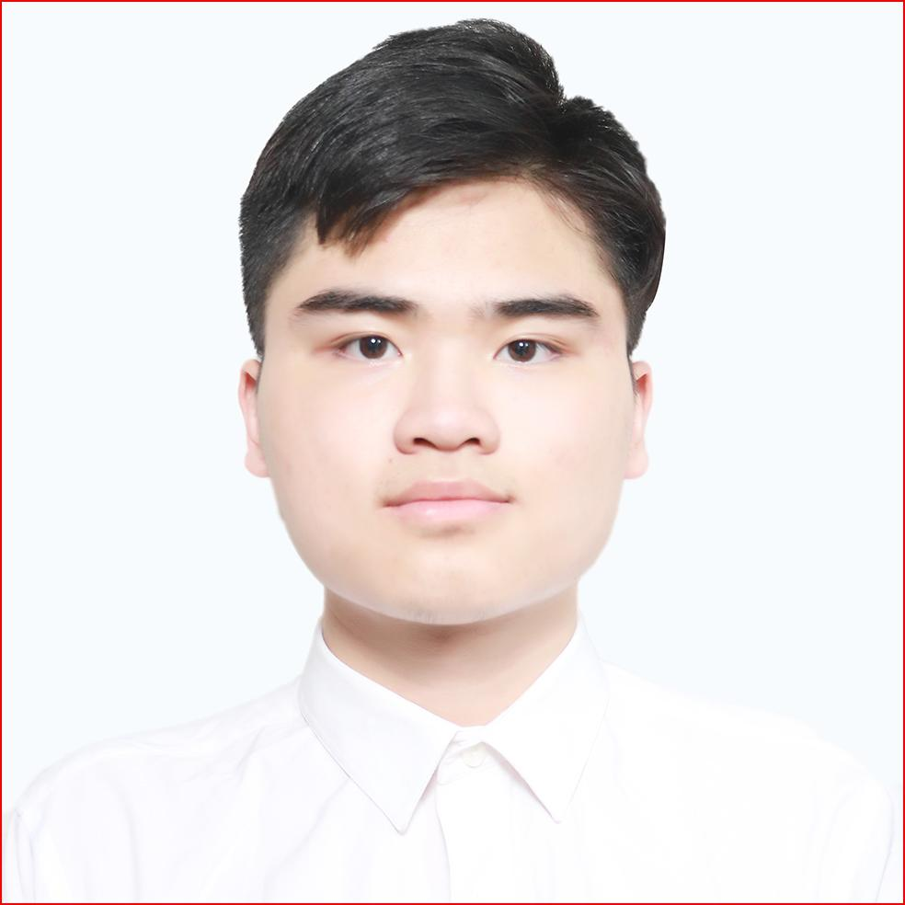
About Us
Gun Woo Kim
Trung Le
Kory Rosen
Minh Nguyen
Devanshu Pandey

Slide 5
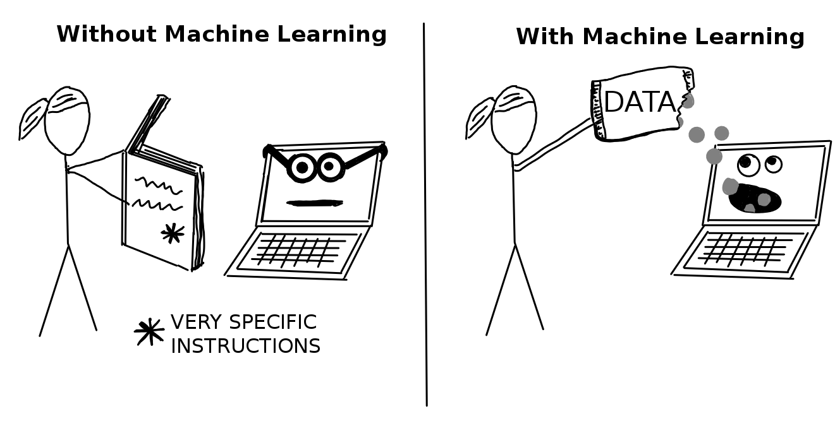
What is ML?
Learn to improve algorithms from data.
Why?
Humans expertise does not exist
Humans are unable to explain
Solutions change or adapt over time

Slide 6
Why ML?
DS
MLE
Quant?
Grad School

Slide 7
Kahoot time!

Slide 8
Club Direction
Learning:
Weekly masterclass sessions
Update recent advances of ML/AI fields
Participating:
Kaggle
Datathon (collaboration w/ DASIL?)
Other ML competitions
Build projects, read papers
Connecting:
Connect to professors and professionals in the fields
Notes:
Like Let’s have lunch together, add on linkedin, share ideas, we are more like an association or a community. Let’s learn latest industry techniques and rly become good in the field.

Slide 9
This semester
Learn ML algorithms.
Learn DL / review ML
Step into Kaggle

Slide 10
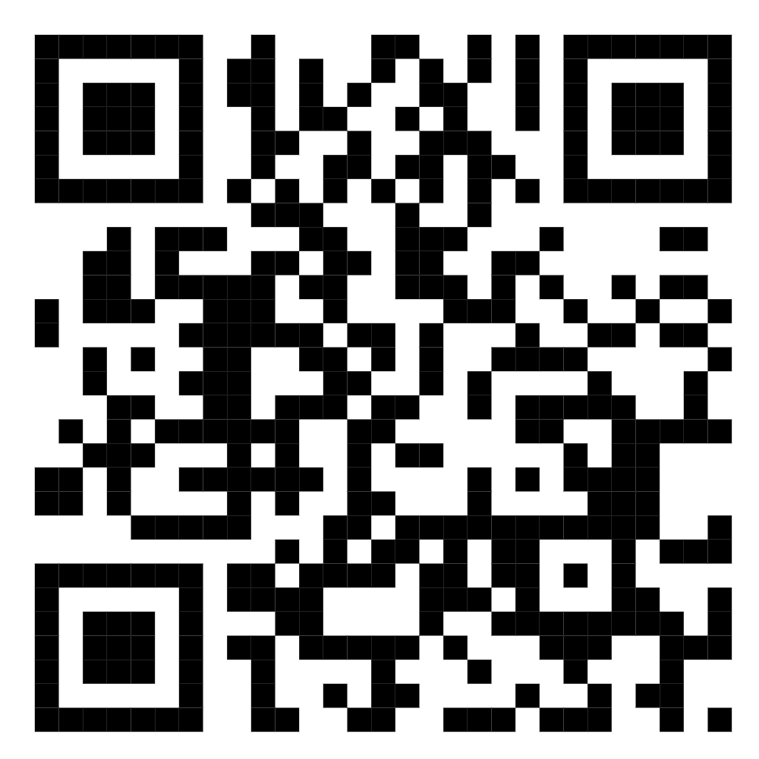
Icebreaker activity: Two Truths and One Lie
Each takes turns introducing & sharing 2 truths and 1 lie about themselves.
Others then collectively guess which statement is the lie, rating their confidence on a scale of 1-10.
The facilitator also rates their confidence in believing the group is wrong on a scale of 1-10.
Record data on the form: https://tinyurl.com/468xezfn
Submit a new form for each person.

Slide 11
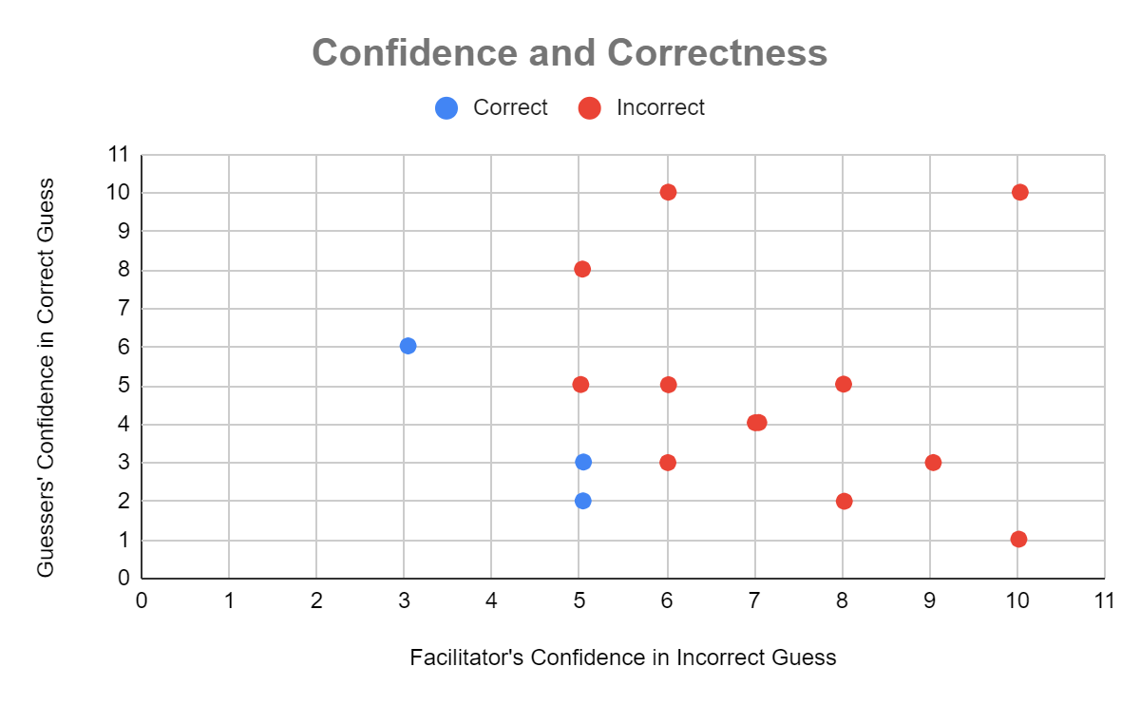
Data - 2T1L
Notes:
https://infoinspired.com/google-docs/spreadsheet/conditional-coloring-scatter-plot-in-google-sheets/

Slide 12
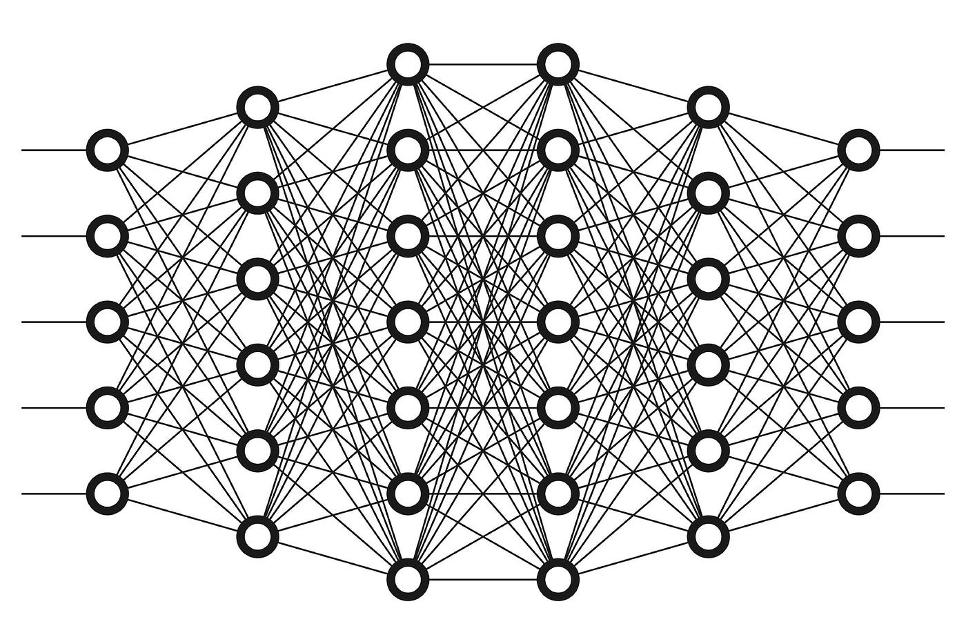
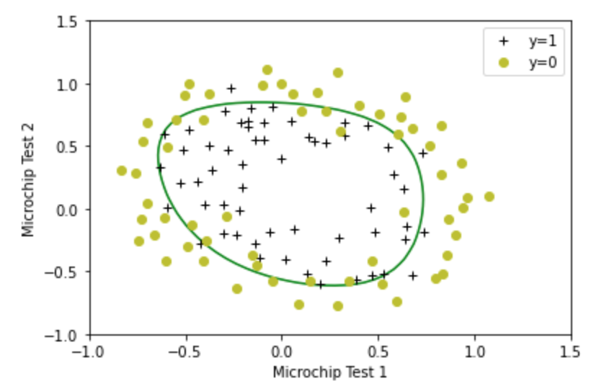
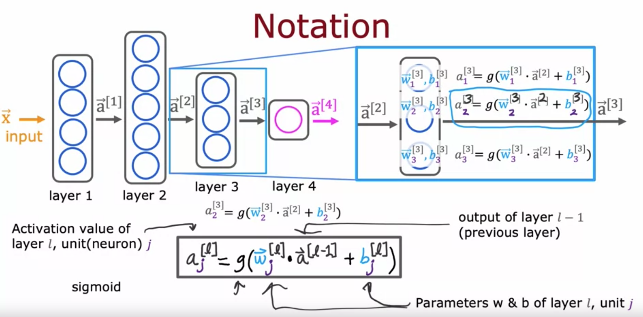

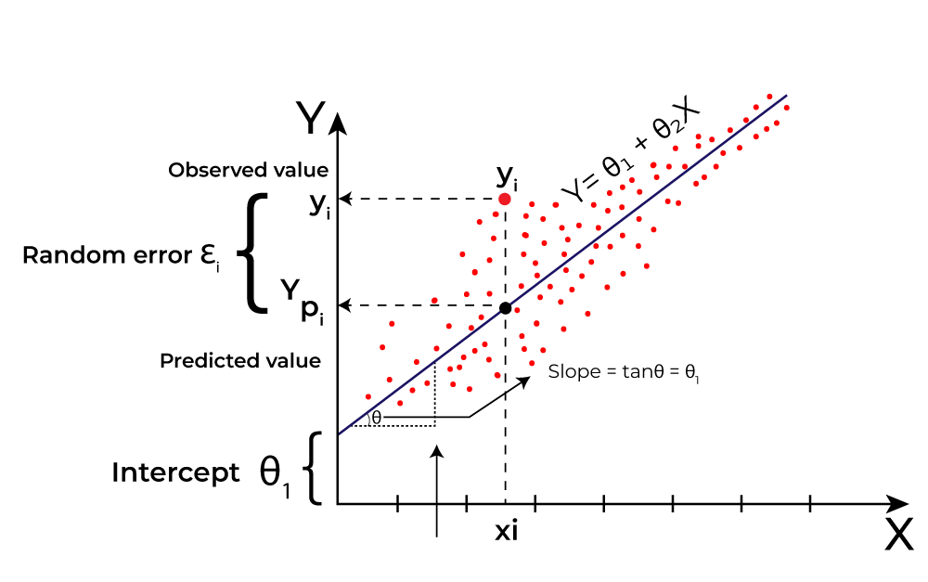
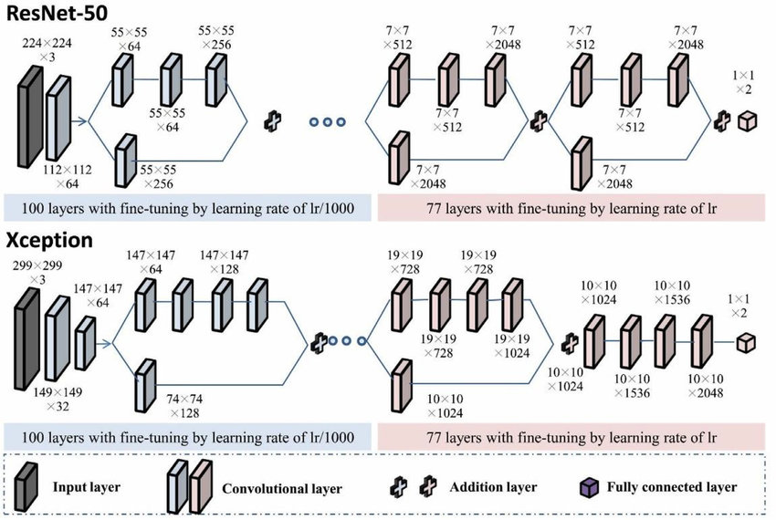
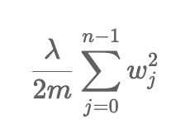
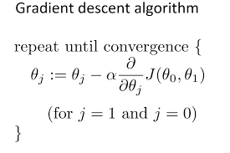
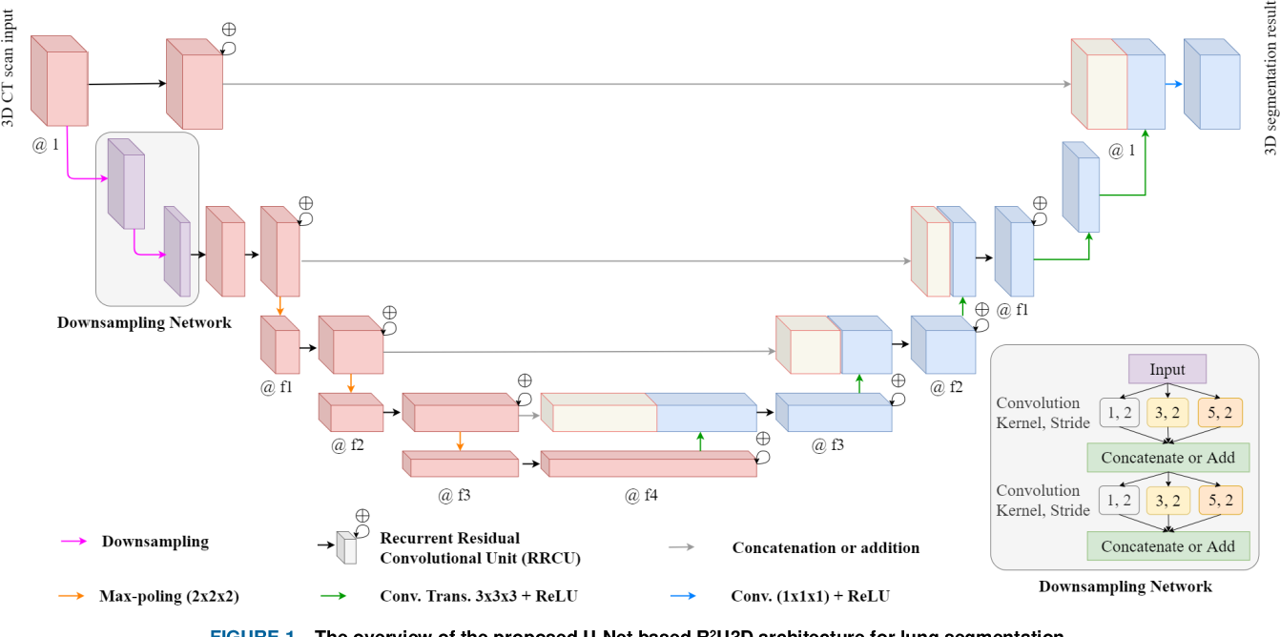

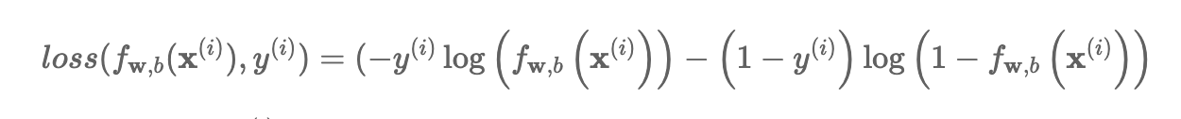
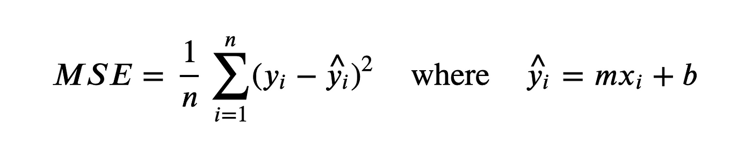
ML / DL

Slide 13
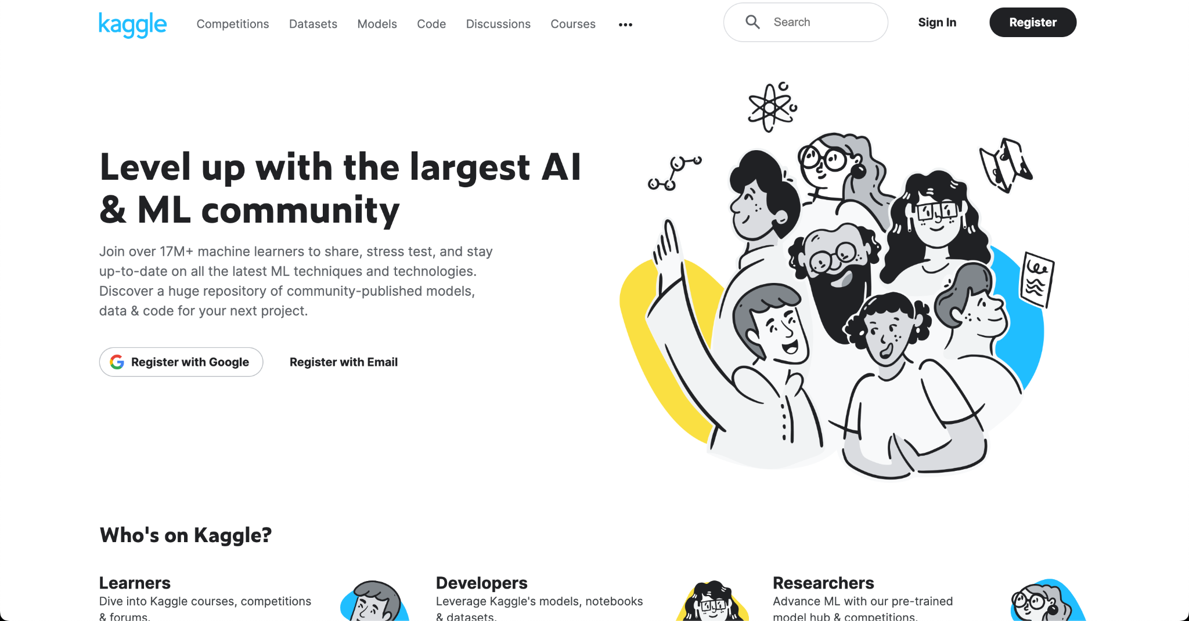
Kaggle
Biggest AI/ML learning platform
17 million users

Slide 14
Why Kaggle?
Learn ML in practice
Build projects
Explore and specialize in different areas (Vision, NLP, Tabular)
Kaggle’s sharing culture → learn from experts’ answers
Ranking system motivates to keep learning!

Slide 15
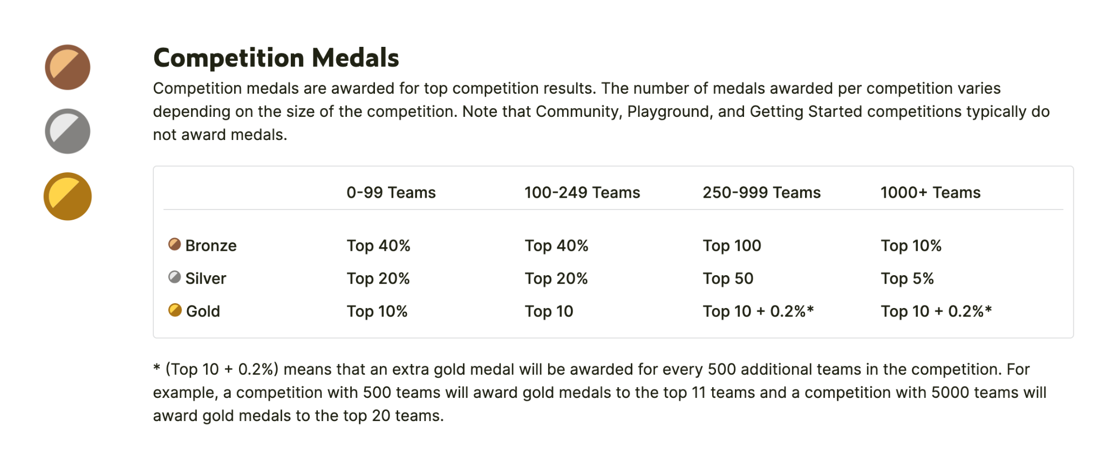
Kaggle Competition System

Slide 16
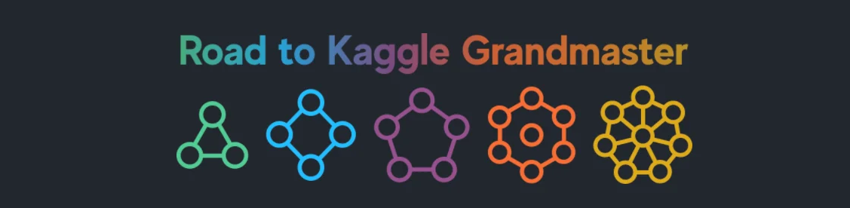
17,079,961 Novices
16,159 Experts
499 Grandmasters
232,409 Contributors
2,600 Masters.

Slide 17
Next Semester
Kaggle Competition in teams
on-site competitions
projects
open to public.
current members can lead sessions next semester.

Slide 18
Next Session
Python and Numpy Fundamentals for ML

Slide 19
Thanks for coming!
Notes:
biggest club!

